Slide 1
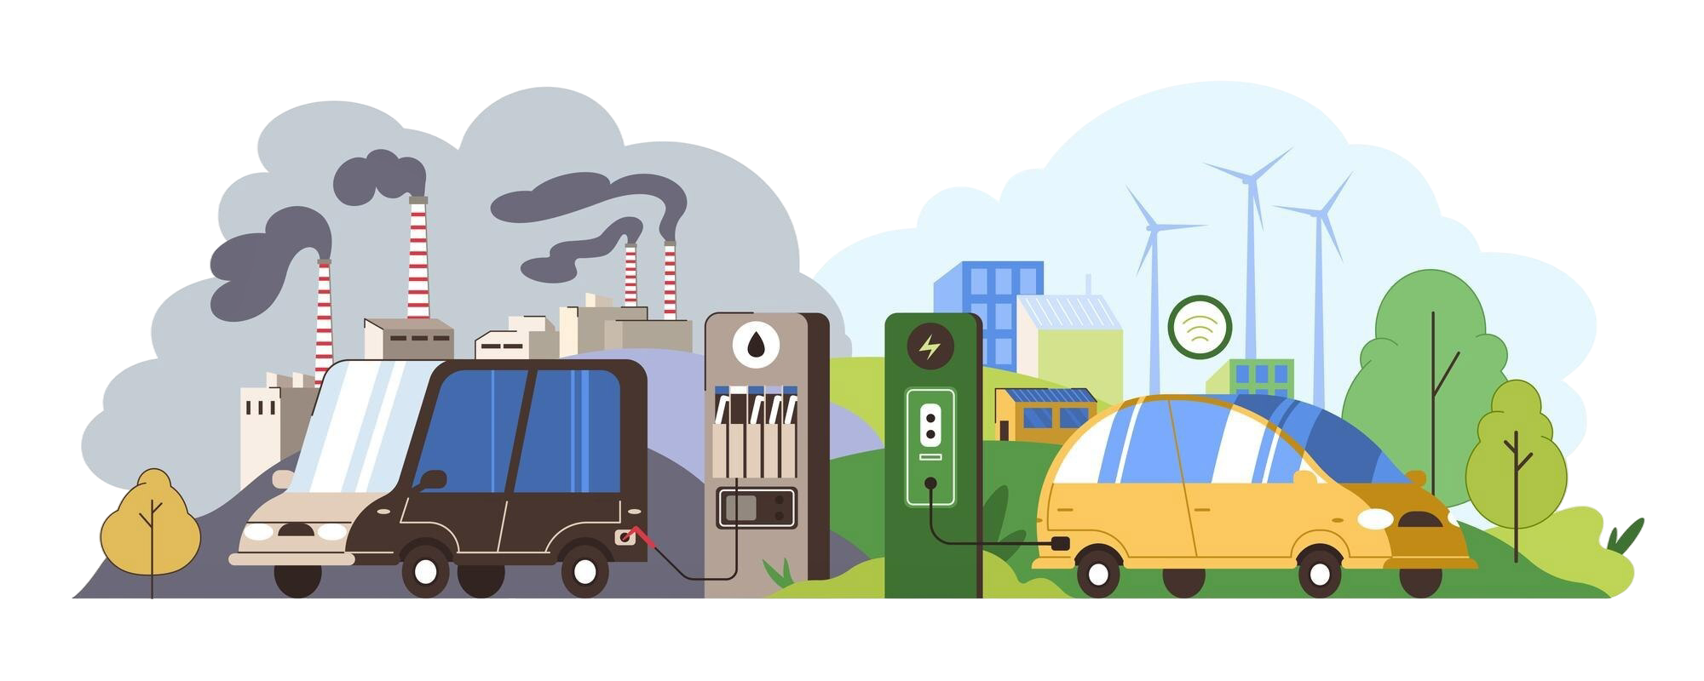
SPRINGBOARD DATA SCIENCE CAREER TRACK · CAPSTONE THREE · SAILEE GAWANDE
Accelerating Electric Vehicle Adoption
A County-Level Framework for Targeted Infrastructure Investment
Executive Briefing | Washington State Case Study, 2017–2025
1
Notes:
Opener: I chose Accelerating Electric Vehicle Adoption as the topic for Capstone 3 project because Healing the Planet and making this world a better place both motivate me as a person.
I will talk about the problem, the opportunity, what I found, and what I recommend doing about it in this presentation.

Slide 2
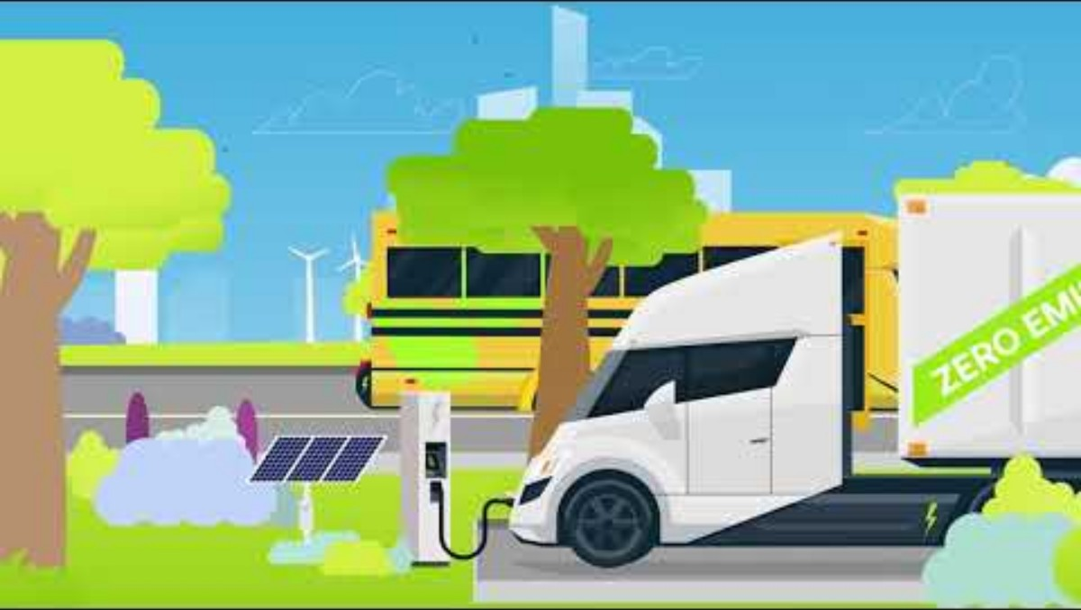
THE PROBLEM
2
Notes:
This video by American Lung Association helps in making the problem tangible (the emissions/climate stakes) before I can dive into data.

Slide 3
THE OPPORTUNITY
Targeted Allocation of Public dollars for EV Infrastructure & Policies
~28%
of 2022 U.S. greenhouse gas emissions came from transportation (EPA — see Sources, slide 14)
This project builds a scalable, data-driven framework
- using Washington State as a case study
- to identify optimal locations for EV related investments to maximize adoption & ROI
3
Notes:
As seen in the video, transportation is a leading source of U.S. emissions, and EVs are one of the few levers we can move on quickly.
To assign numbers, ~28% of 2022 U.S. GHG emissions came from transportation (EPA) —
"So the question isn't whether EVs matter — it's where to focus the money so they matter most."
Core message: infrastructure dollars are limited and expensive, so misallocating them to low-impact counties is a real cost, not just an inefficiency.
“So, the attempt here is to build a framework to tell us exactly where investment will and won't work — and why."

Slide 4




OUR APPROACH
Two models, one goal: know where — and why — to invest
1. Unify Data
2. Model Drivers
3. Segment Counties
Five Washington State sources (2017 – 2025) County/Year Level
Ridge regression for quantification
K-Means clustering for segmentation
FOUNDATION
PREDICTION
SEGMENTATION
4
Notes:
Basic Framework was to unify the data, model what drives adoption, then segment counties by profile.
Five Washington State sources — EV registrations, vehicle registrations, income, population, and charging stations — merged to the county-year level, 2017–2025.
A Ridge regression quantifies which factors actually move county-level EV adoption, and by how much.
K-Means clustering groups Washington's 39 counties into three adoption profiles, each facing a different constraint.

Slide 5


DATA & METHODOLOGY
Five state datasets, two modeling approaches
Datasets (WA State, 2017–2025)
Modeling Approach
Source | Provides
Vehicle Registrations | Registered EVs (numerator) & Total registered vehicles (denominator) by county
EV Population Data | EVs by Model Year & Attributes
Median Income (OFM) | County income
Population (OFM) | County population
Charging Stations (WSDOT) | Public charger locations
Model | Predicts | Key Inputs
Ridge Regression | County adoption rate | Prior adoption, income, charging density, population
K-Means Clustering | County segments | Income, charging density, population
5
Notes:
KEY STEPS
Merged 5 sources to county-year level (39 counties) → Engineered adoption-rate target & prior-year lag → Transformed skewed features (Yeo–Johnson) & checked multicollinearity → Time-aware train/test split to prevent leakage. Ridge Model was trained on 2017–2023 and tested on 2024–2025, so the model was validated on data it never saw during tuning.
Kmeans Model used the most recent 2025 snapshot for clustering.

Slide 6
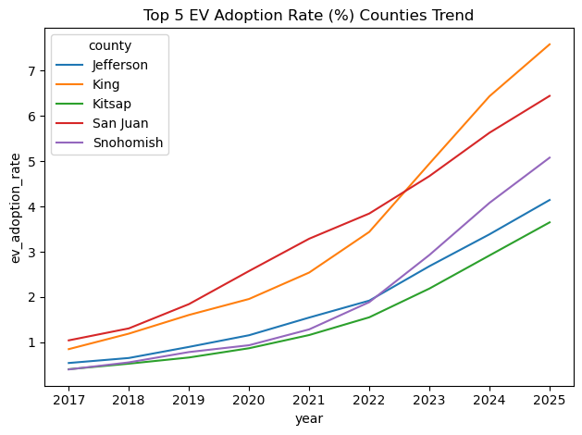
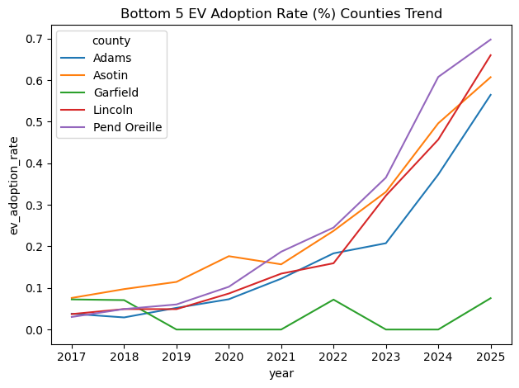
WHAT THE DATA SHOWS
The adoption gap between counties is very wide
Top 5 counties by EV adoption rate, 2017–2025
Bottom 5 counties by EV adoption rate, 2017–2025
6
Notes:
Leading counties show exponential, compounding growth. Lagging counties stay near zero — a gap driven by income, infrastructure, and population, not chance.
The counties that lead now are pulling further ahead every year.

Slide 7
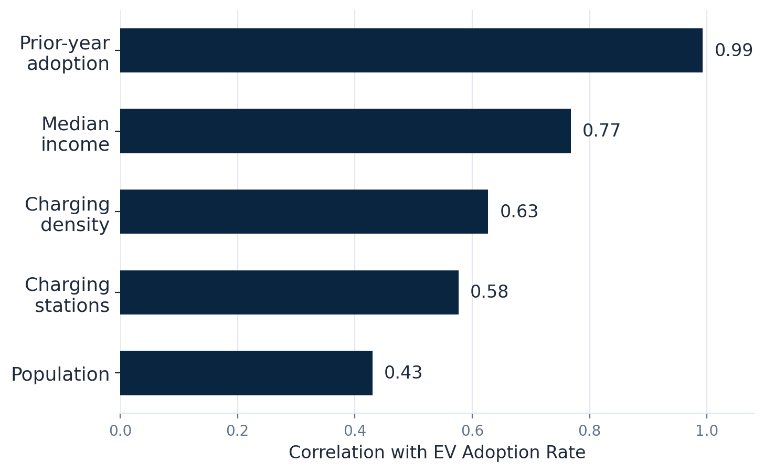
WHAT THE DATA SHOWS
Strong Correlations with Prior year adoption, Income, Charging Density
7
Notes:
These pairwise correlations were computed before any model was built — straight from the merged county-year dataset during EDA phase.
They show that momentum, income, and infrastructure matter most; population matters least.
Raw population correlates positively, but once you control for income and infrastructure (in the regression), its independent contribution shrinks further.

Slide 8

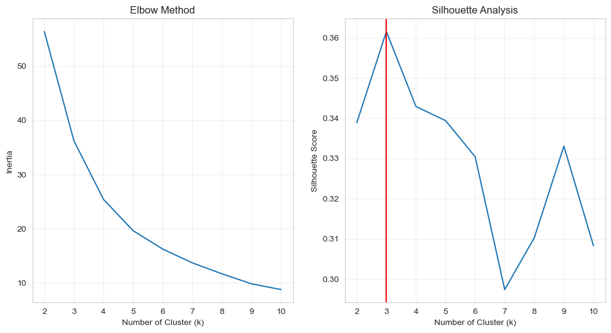
MODEL PERFORMANCE & VALIDATION
Both models were fitted & tested
Ridge Regression — Held-Out Test (2024–2025)
Metric | Value | What it means
R² | 0.96 | Explains 96% of adoption variance
RMSE | 0.14 | Low prediction error
MAE | 0.11 | Predictions close to actual values
Validated with time-aware cross-validation (5-fold TimeSeriesSplit) — the model was never shown future years during tuning.
Elbow method & silhouette score — confirms k = 3 clusters is optimal
8
Notes:
" The model was fit on 2017 to 2023 data and tested on years it had never seen (2024-2025)."
R² = 0.96 means the model explains 96% of the variation in test-set adoption rates — a strong result.
The elbow/silhouette chart on the right is the evidence for why exactly 3 county segments were picked , not 2 or 5.

Slide 9
KEY FINDING 1
Momentum, income & infrastructure — Key Drivers
96%
of the variation in county adoption rates is explained by the model (test data, 2024–2025)
9
Notes:
This chart is based on the feature importance output for Ridge Regression model.
In this case, momentum was ~100 (indexed), income ~17, charging infrastructure ~11, population ~3 — all relative to momentum.
What it shows is that
Early-adopting counties keep pulling ahead — momentum compounds.
Income sets the pace, but isn't the whole story.
Charging infrastructure can meaningfully substitute for income.
Two independent analyses (raw correlation and regression coefficients) pointing to the same drivers gives real confidence in the finding.

Slide 10


KEY FINDING 2
Washington's counties fall into three distinct adoption profiles
High-Adoption Leaders
Rising Markets
Charging Desert
16 counties · 41%
22 counties · 56%
1 county (Garfield)
~3.0%
~1.6%
~0.1%
avg. adoption rate
avg. adoption rate
avg. adoption rate
Income | ~$96K
Charging density | Low
Income | $60K–95K
Charging density | High
Income | ~$71K
Charging density | Zero
King, Snohomish, Clark, and other high-income, high-population counties. Adoption is self-sustaining.
Columbia, Lincoln, Adams, and similar counties. Infrastructure is compensating for lower income.
Comparable income to Rising Markets counties, but zero public charging — momentum never starts.
10
Notes:
Leaders (self-sustaining), Rising Markets (infrastructure compensating for income), Charging Desert (Garfield County, the one true outlier).
Garfield is the single most actionable insight on this slide: comparable income to Rising Markets counties, but zero charging — that's a solvable, bounded problem.
These profiles indicate that each segment will map to a different funding strategy

Slide 11
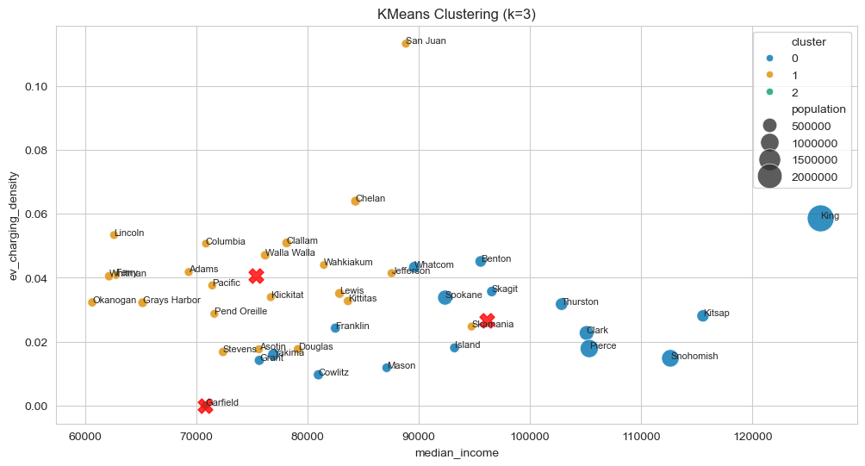
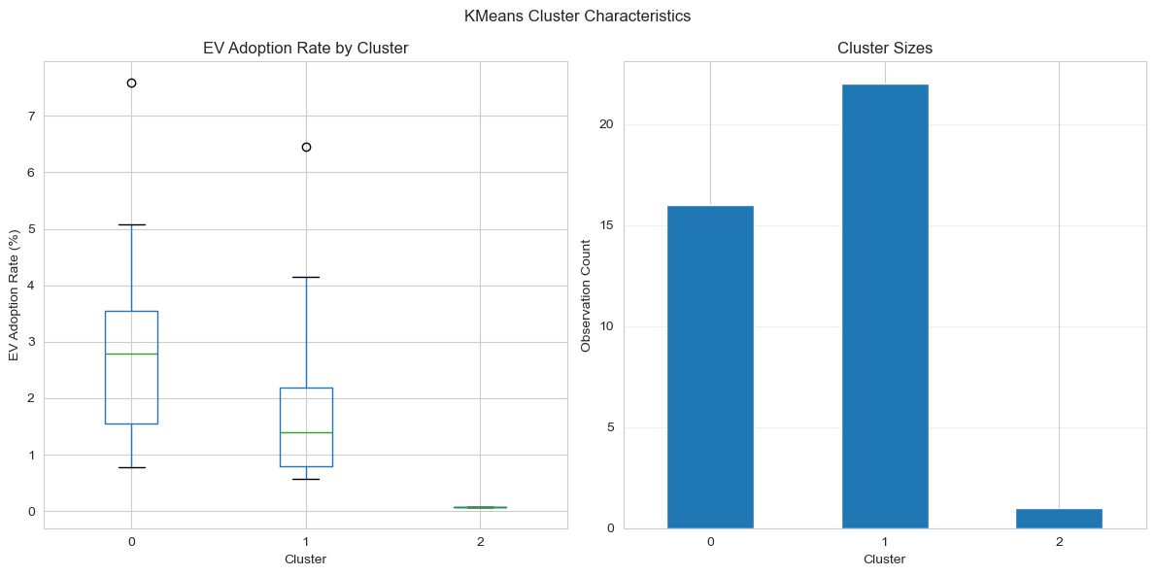
SEGMENTATION VISUALIZED
Income and infrastructure separate the three groups effectively
Counties plotted by income vs. charging density, sized by population; × marks cluster centers
Adoption rate and county count by cluster — confirms the 3 groups are meaningfully different
11
Notes:
Left chart shows Counties plotted by income vs. charging density — you can see the three groups separate except one or two counties that are separate on z axis of population (not shown here) as they have lower population. The × marks show cluster centers.
Right chart: confirms the groups aren't just visually different but statistically different in adoption rate and size.

Slide 12
THE RECOMMENDATION
A three-phase roadmap, matched to funding source
1
PHASE 1
2
PHASE 2
3
PHASE 3
Foundation
Activation
Autonomy
GARFIELD COUNTY
RISING MARKETS COUNTIES
HIGH-ADOPTION LEADERS
Seed baseline highway-corridor charging to eliminate the state's only total charging desert.
Vehicle purchase rebates and used-BEV subsidies to unlock pent-up demand; maintain fast-charger uptime.
Rely on private commercial capital for destination charging; public spend limited to grid capacity and select low-income pockets.
FUNDING
FUNDING
FUNDING
100% public capital
Public rebates + private matching
Mostly private capital
12
Notes:
Phase 1 (Garfield): small, bounded, public-capital investment — low cost, clears the one true infrastructure gap in the state.
Phase 2 (Rising Markets): demand-side rebates, very few charging stations as needed, just maintenance and uptime— infrastructure is already there.
Phase 3 (Leaders): recommend stepping back from public spend — private/commercial capital can carry this segment on its own.

Slide 13

WHY IT MATTERS
Concentrate scarce public capital where it changes outcomes
Closes the state's one true charging desert
Activates demand where infrastructure is ready
A single targeted investment in Garfield County removes the only structural barrier where infrastructure — not income — is the constraint.
Rising Markets counties already have charging supply; rebates convert existing infrastructure into adoption.
Frees public capital for where it's needed most
Built to scale beyond Washington
High-Adoption Leaders can be served by private commercial investment, redirecting public dollars elsewhere.
The same data pipeline and models can be re-run on any state with comparable registration and infrastructure data.
13
Notes:
Public capital for EV initiatives and policies is scarce and precious so each of the 4 points as alluded to on the previous slide can create a focused impact for EV transitions with effective utilization of public funding.
Its scalability is beyond Washington State.

Slide 14

CONCLUSION
The data points to a clear, fundable strategy
EV adoption is not random — it is driven, predictably, by momentum, income, and infrastructure. Knowing which of those three is binding in a given county tells us exactly what kind of investment will move the needle there.
Regression
Clustering
Roadmap
Quantifies what drives adoption and by how much (R² = 0.96).
Turns those drivers into 3 actionable county segments.
Matches each segment to the right funding mechanism.
14
Notes:
EV adoption is predictable, and knowing which factor is binding for a particular location, county in our case tells you what kind of investment will work.
(Regression / Clustering / Roadmap)

Slide 15

NEXT STEPS
Recommended path forward
1
Pilot a highway-corridor charging investment in Garfield County
2
Design a rebate / used-BEV subsidy program / (infrastructure as needed) for Rising Market counties
3
Engage private and utility partners on buildout in Leader counties
4
Extend the framework to additional states for broader validation
15
Notes:
These are the 4 most actionable items if we would like to get started today.

Slide 16
SOURCES & CITATIONS
Data sources and references
Datasets (Washington State Open Data, 2017–2025)
Dataset | Source
Electric Vehicle Population Data | data.wa.gov/Transportation/Electric-Vehicle-Population-Data/f6w7-q2d2
Vehicle Registrations by Class and County | data.wa.gov/Transportation/Vehicle-Registrations-by-Class-and-County/hmzg-s6q4
Median Household Income Estimates | ofm.wa.gov/data-research/economy/median-household-income-estimates
Population Estimates | ofm.wa.gov/data-research/population-demographics/estimates
EV Charging Stations Data | ev-map-wsdot.hub.arcgis.com
Additional references
U.S. EPA, "Sources of Greenhouse Gas Emissions" — transportation share of 2022 U.S. emissions (epa.gov/ghgemissions/sources-greenhouse-gas-emissions), cited on slide 3.
American Lung Association Video on Electric Vehicle Solution — https://www.youtube.com/watch?v=V5w2TiEohs8 on slide 2.
Full methodology, assumptions, and limitations are documented in the accompanying project report and README.
16
Notes:
Full dataset URLs and the EPA citation are listed for anyone who wants to verify independently.
The accompanying project report/README link can be referred to for full methodology, limitations, and assumptions.

Slide 17




Thank You
Questions & discussion
gawandesailee@gmail.com
GitHub Repository Link
linkedin.com/in/saileegawande
17

